Slide 1
Vehicle Dynamics and Simulation
Parameter Tuning
Dr Byron Mason

Slide 2
Overview
Motivation
How good is the model
Plots
Metrics
Optimisation
Parameter optimisation in MATLAB

Slide 3
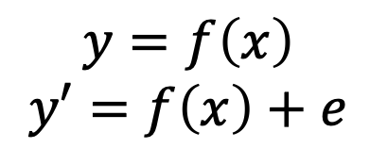
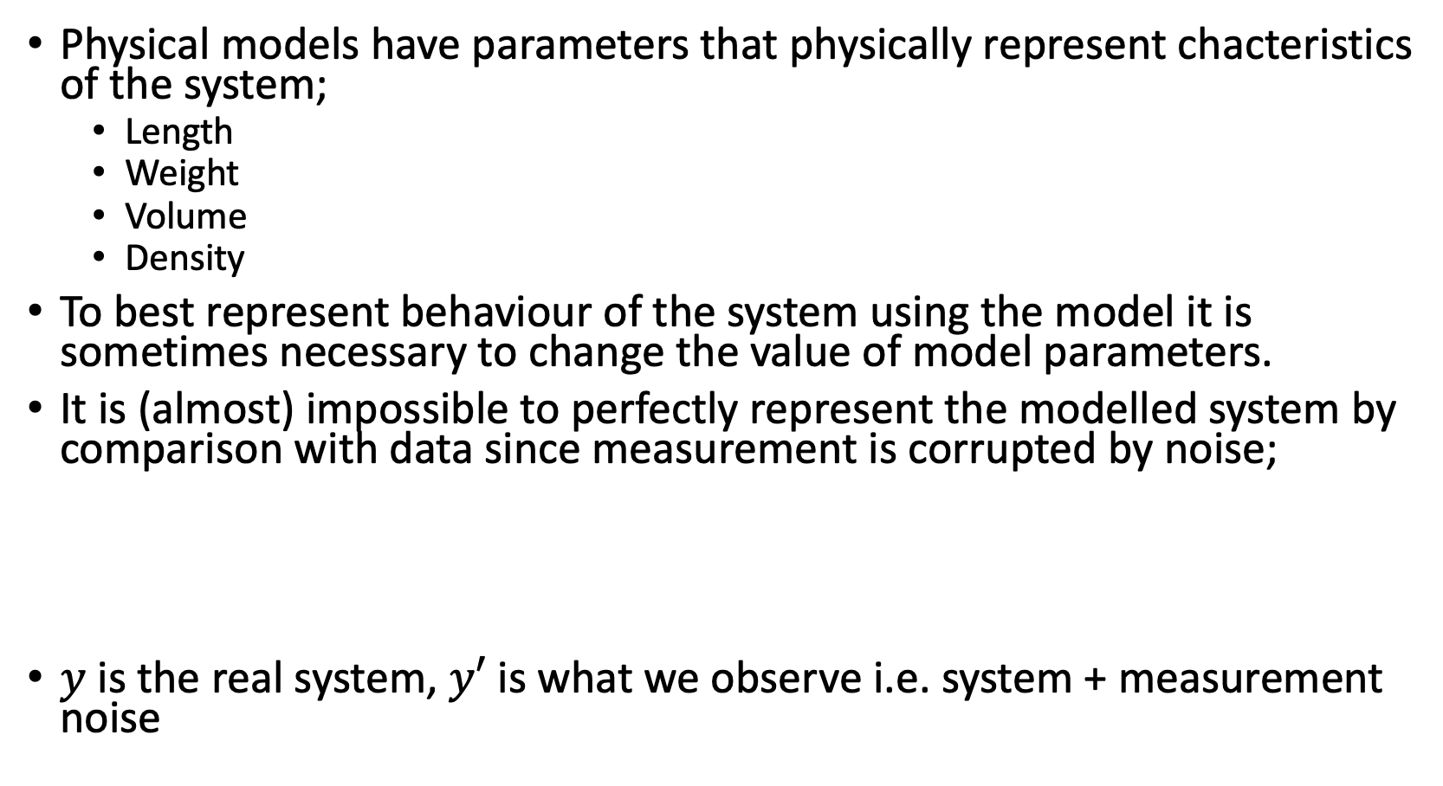
Motivation
Physical models have parameters that physically represent chacteristics of the system;
Length
Weight
Volume
Density
To best represent behaviour of the system using the model it is sometimes necessary to change the value of model parameters.
It is (almost) impossible to perfectly represent the modelled system by comparison with data since measurement is corrupted by noise;
$y$ is the real system, $y′$ is what we observe i.e. system + measurement noise
$$y=f\left(x\right)$$
$$y′=f\left(x\right)+e$$

Slide 4
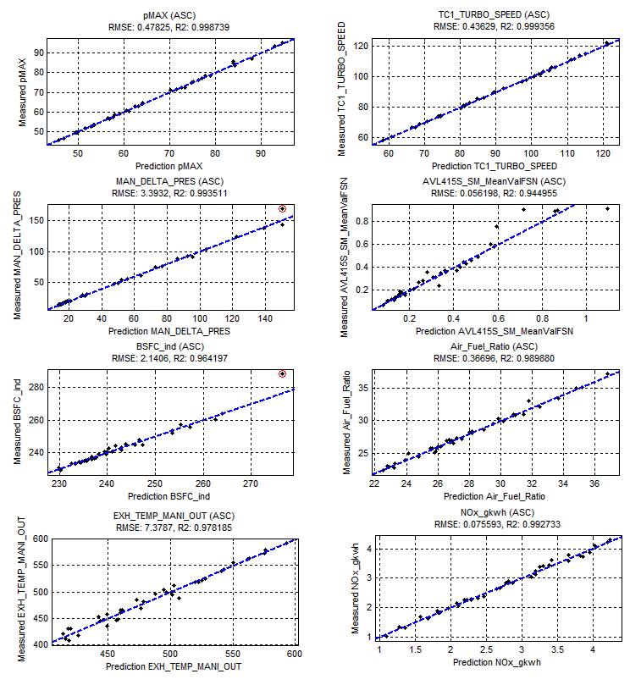
Prediction vs Data
The difference between a model and the real system that it describes can be shown in a number of ways;
Time series plot
Correlation plot
Residuals plot
Each of these gives a slightly different view of the models ability to represent the real system

Slide 5
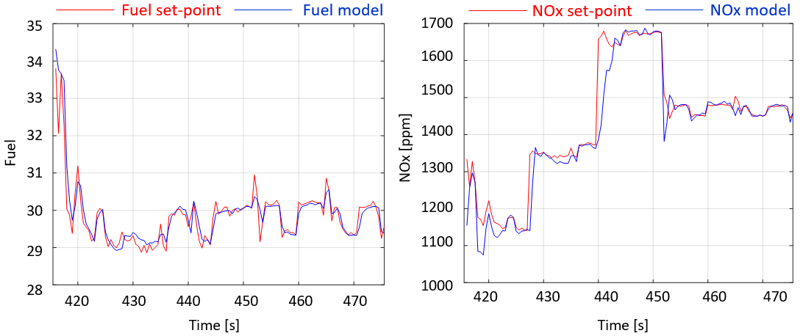
Timeseries plot
Perhaps the most intuitive and common approach to evaluating the difference between model and reality.
Easy to see where (in time) the model is struggling to explain the system behaviour.
It can be misleading since many small differences can sum to large cumulative difference. Whether this is important or not depends on the model use.

Slide 6
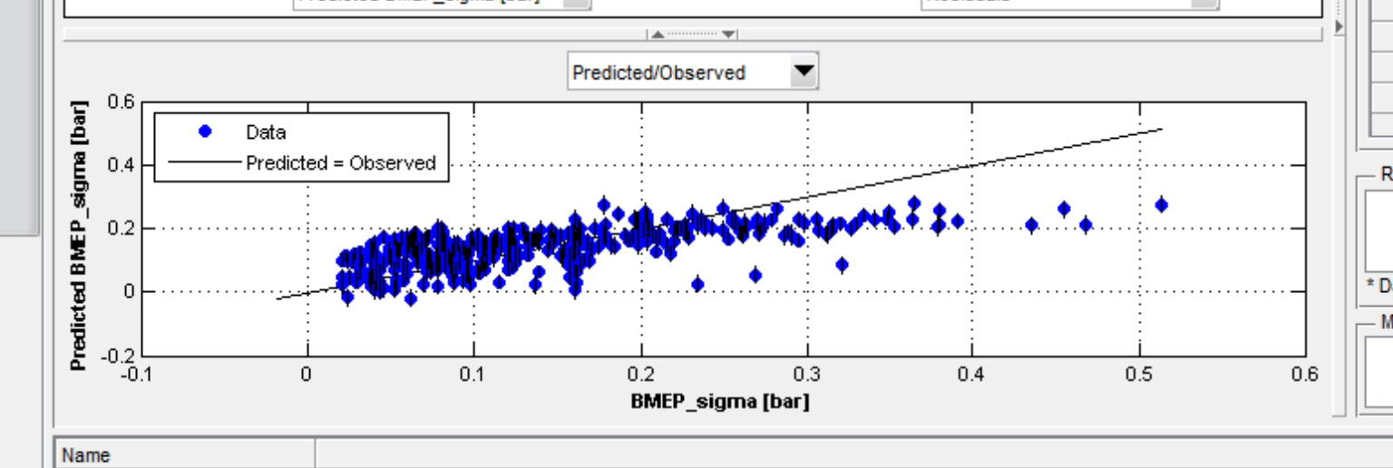
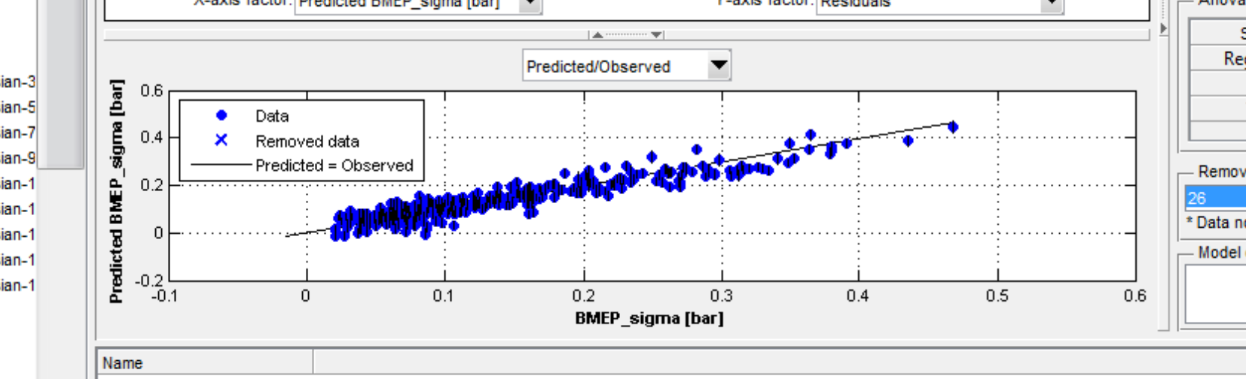
Correlation plot
Bad correlation. High model error. For high BMEP_sigma the predicted is lower than measured BMEP_sigma
Good correlation between model and measured data.

Slide 7
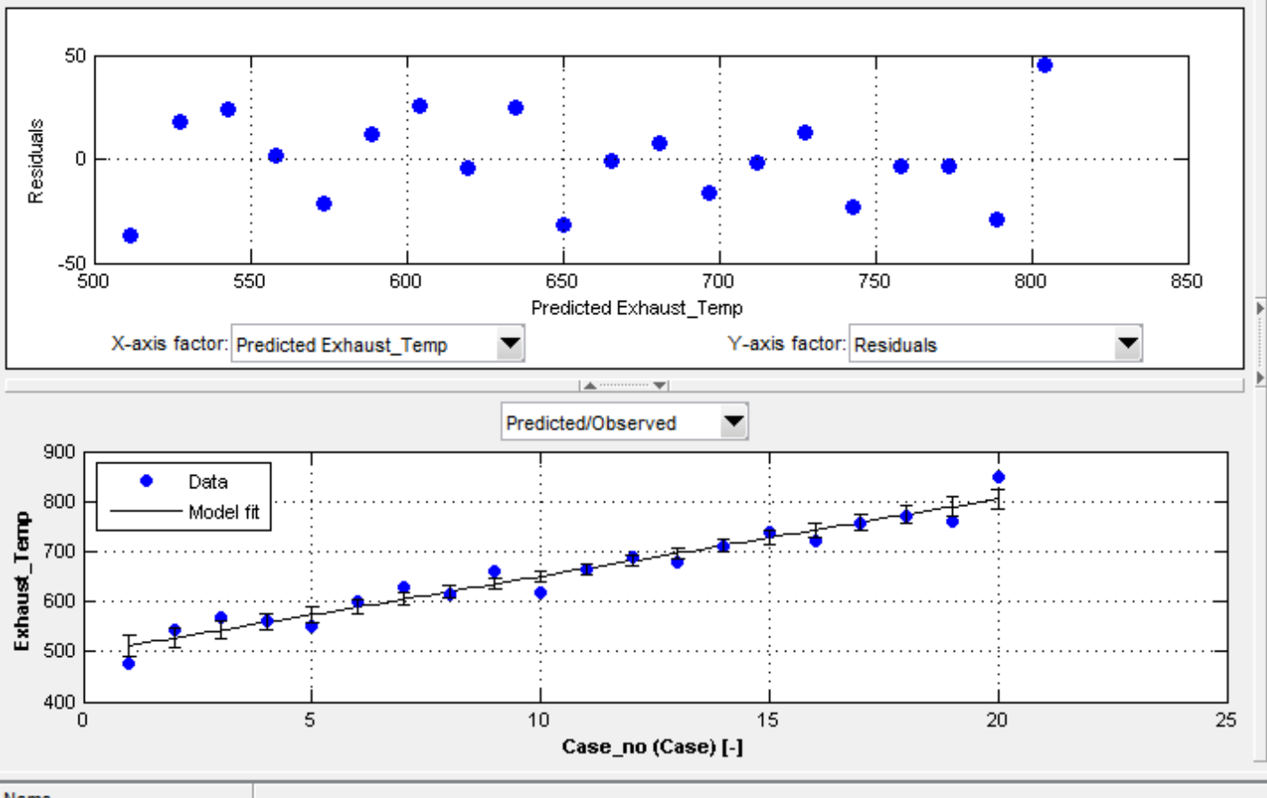
Residuals plot
A correlation plot between the measured dataset and model fit is plotted.
Residuals are simply what is left after the model has been fitted - the unexplained variation
Residual = data – fit(model)
Any structure in the residuals is indicative of a model that isn’t fully explaining the data.

Slide 8
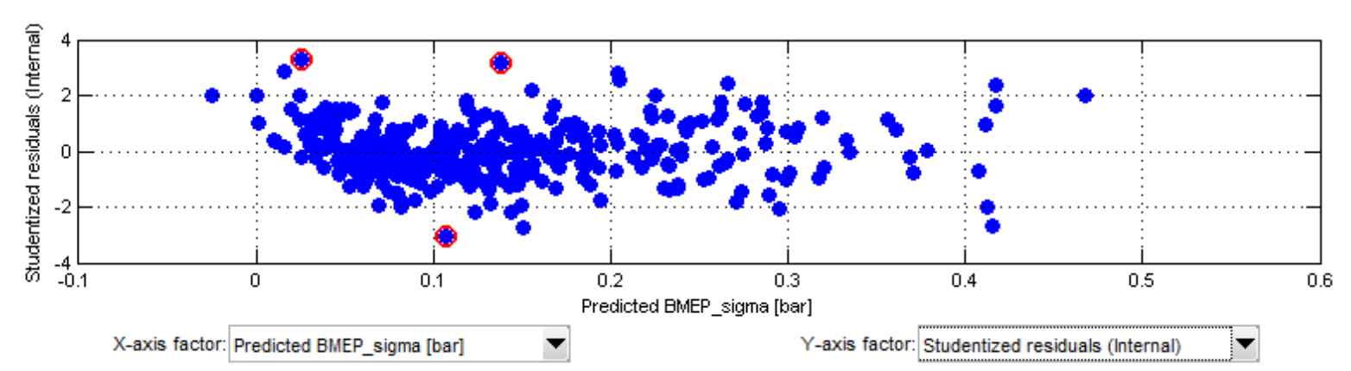
Outlier plot
Outliers are usually defined in terms of normal distribution. Points that are not with the 10-90% of distribution are declared as outliers.
The definition of outlier is a subjective matter. It depends on the modeling error, PRESS statistics or validation results.
Outlier region
Outliers
Residuals

Slide 9
Metrics
In addition to the obvious visual inspection of model performance a plethora of metrics exist to quantify the performance of the model.
Each has a different purpose.
The most common are;

Slide 10
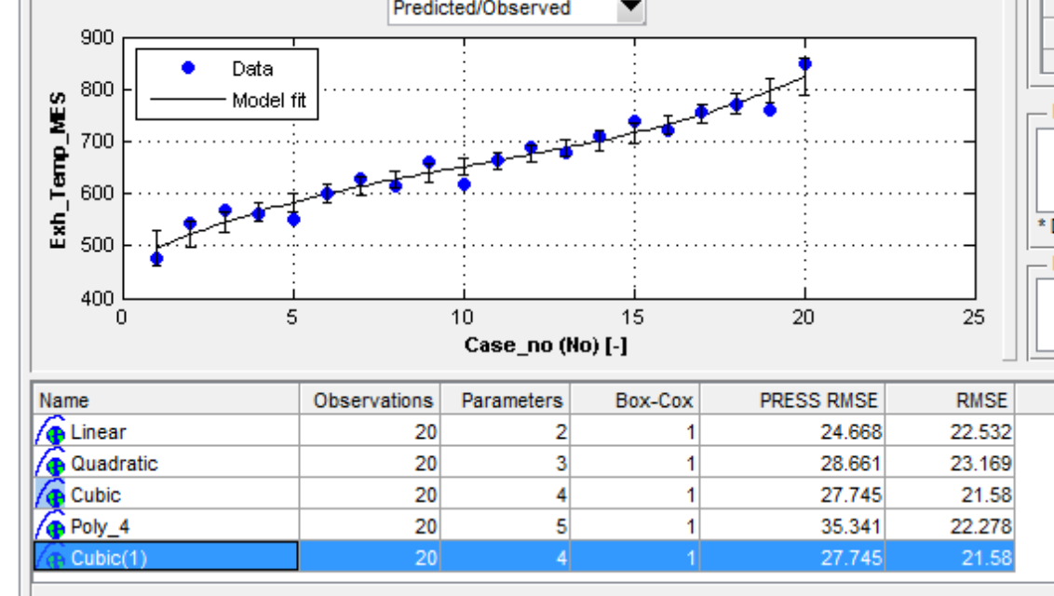
Model evaluation - Error - RMSE
For example, an exhaust temp dataset was modeled using 4 types of model: linear, quadratic, cubic and 4th order polynomial. The table below shows the difference of RMSE between the models. The best model is selected based on RMSE.
RMSE is the root square of the mean(norm) of all squares of error
Model with smallest RMSE is usually selected. But RMSE alone doesn’t guarantee model fitness because that is training RMSE.
Typically, RMSE (between model and validation data) or PRESS RMSE are used as an indicator for model selection.

Slide 11
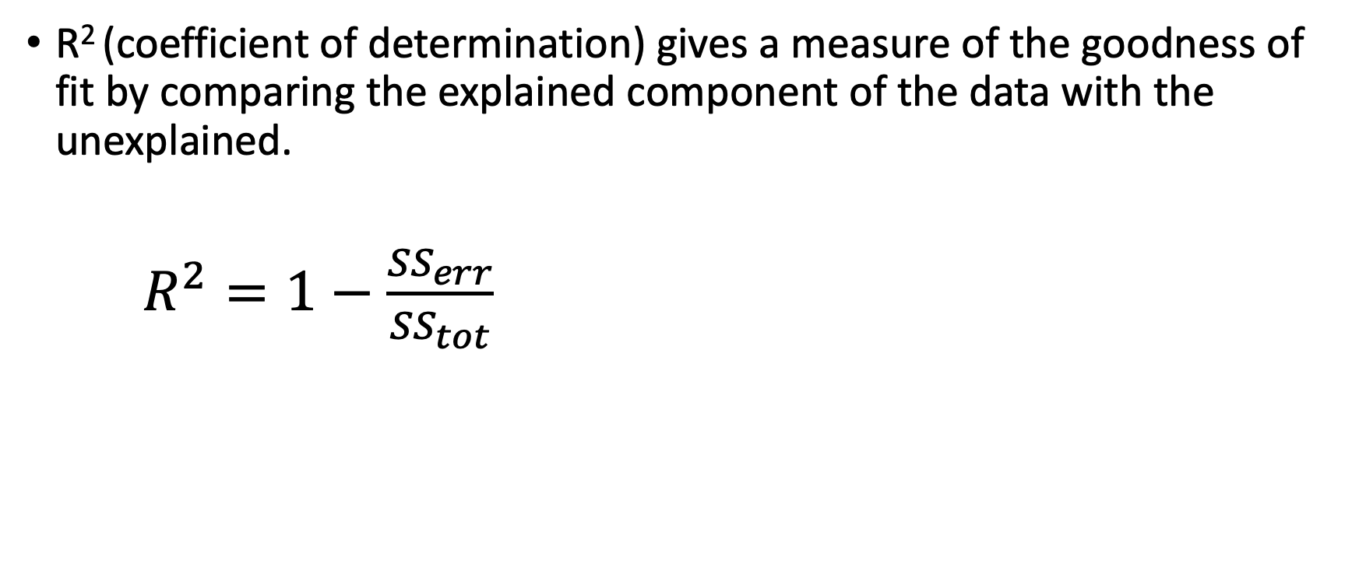
Model evaluation - Error - R²
R² (coefficient of determination) gives a measure of the goodness of fit by comparing the explained component of the data with the unexplained.
$R^{2}=1−\frac{{SS}_{err}}{{SS}_{tot}}$
Unexplained variation
Total variation

Slide 12
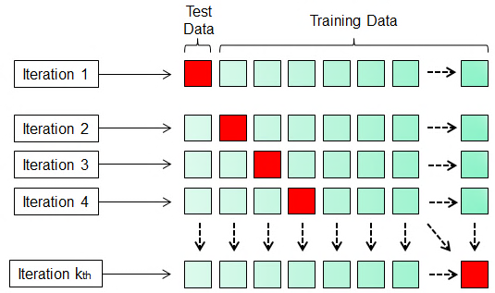
Model evaluation - Error – PRESS RMSE
The PRESS statistic gives a good indication of the predictive power of your model
PRESS statistics is a method to validate a model without having to use validation data.
The same training data is use to validate the model.
Iteratively, a fraction of training data use as validation data and the rest use as training data. The cycle is iterated until all fraction of training data have been once used for validation data. The RMSE are calculated for each iteration. Finally, the average of RMSE is calculated.
PRESS R² can be calculated using the same procedure
RMSE
RMSE
RMSE
RMSE
RMSE
PRESS RMSE = SUM(RMSE)/k

Slide 13
Method
Change to parameters can be done in several ways
Trial and error approaches (for simple models)
Direct optimisation (for low parameter numbers and computationally efficient models)
Through a meta-model (high order computationally demanding model)

Slide 14
Optimisation
Optimisation is the process of minimising a cost function
In an optimisation process a cost function is formulated and minimised.
The Cost function contains quantities to be minimised.

Slide 15
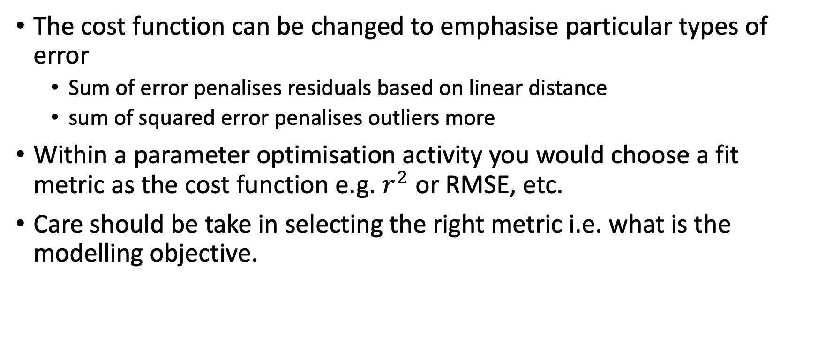
Optimisation
The cost function can be changed to emphasise particular types of error
Sum of error penalises residuals based on linear distance
sum of squared error penalises outliers more
Within a parameter optimisation activity you would choose a fit metric as the cost function e.g. $r^{2}$ or RMSE, etc.
Care should be take in selecting the right metric i.e. what is the modelling objective.

Slide 16
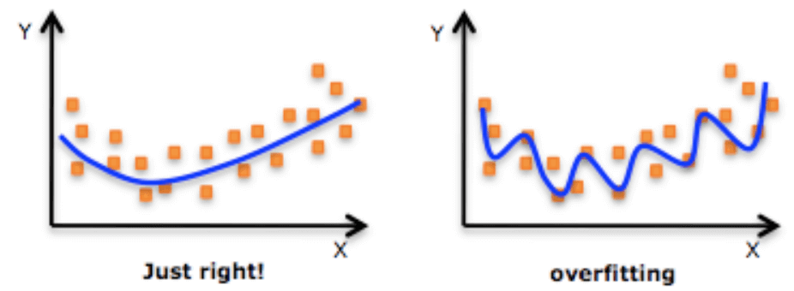
Optimisation
Care should be taken to avoid overfitting.
This is not really an issue with physical models.

Slide 17
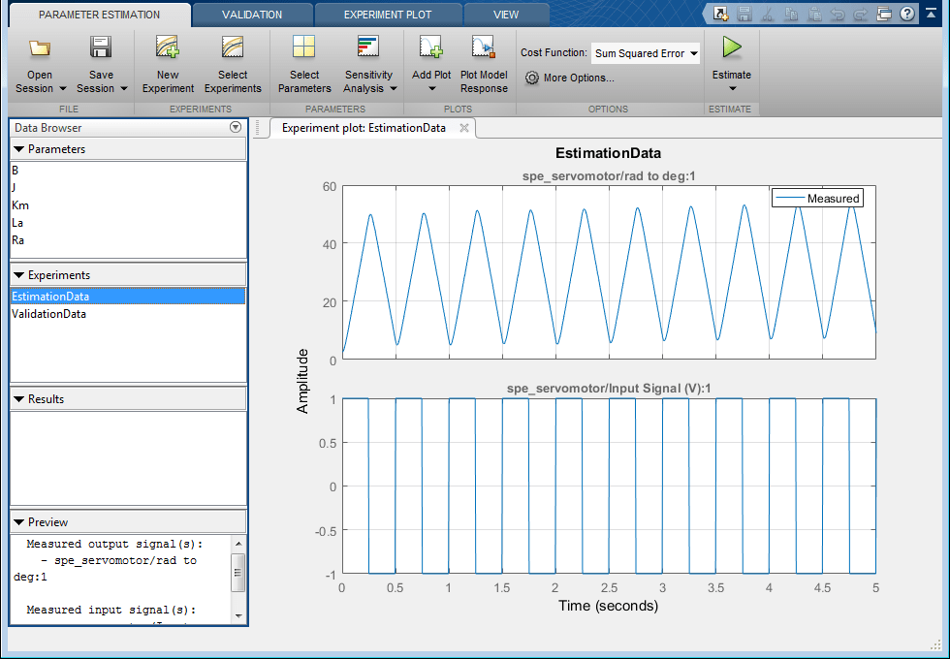
Parameter Optimisation in MATLAB
MATLAB/Simulink has a model parameter tuning GUI.
Leverages MATLAB optimisation algorithm to minimise a cost function.
The cost function and optimiser used can be changed through the GUI

